Slide 1

Project On:
“Evento- Event Management System”
PG-DAC Sept-2021
Guided By: Bakul Joshi.
Submitted By :
Dinesh Parate 210943020020
Akash Kadam 210943020005
Rohan Shirsat 210943020072
Shailesh Sarode 210943020083

Slide 2
Introduction
Need :-
Organizing the event needs variety of services from different vendors like decoration ,Catering etc.
There is no system available currently which provides a common platform for searching the different vendors required for various services for a particular event , currently customer ,corporate companies visit to nearest vendor who provides services such as decoration, catering, photography etc.
for booking their services for their event if one of them vendor is already booked by someone else then searching another vendor for event is time consuming and tedious task for customers and corporate companies.
Objective:-
The main objective of the system is to build an event management web Application to help customers , corporate companies to arrange their events like Birthday ,wedding. Training.

Slide 3
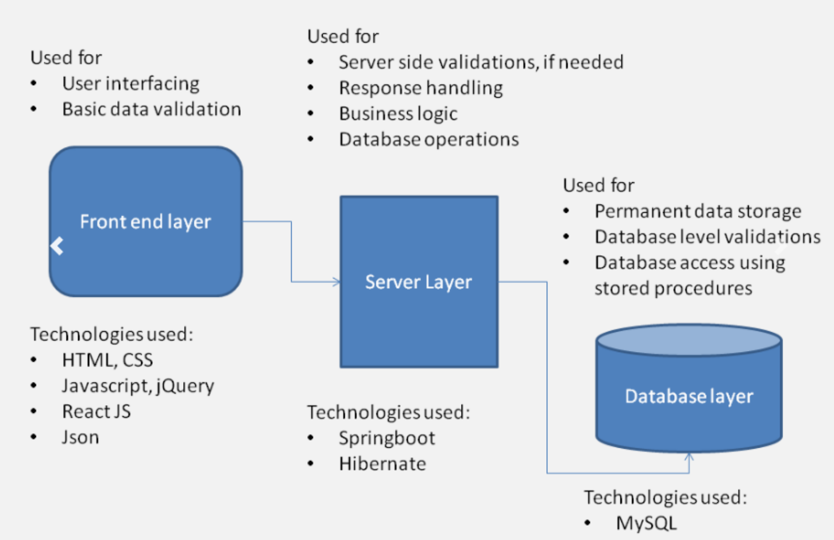
Project Architecture

Slide 4
Reason for selecting Technologies
Spring Boot :- It provides a flexible way to configure Java Beans, XML configurations, and Database Transactions. It provides a powerful batch processing and manages REST endpoints. In Spring Boot, everything is auto configured; no manual configurations are needed.
React :- React allows developers to create large web applications that can change data, without reloading the page. The main purpose of React is to be fast, scalable, and simple. It works only on user interfaces in the application. This corresponds to the view in the MVC template.
MYSQL :- Easy to use: As it supports SQL language, users don't need to be technically expert to access the database. It can be easily accessed by users with basic SQL knowledge and experience on other relational databases

Slide 5
User roles and Responsibilities
User Roles :- Customer , Vendor, Admin are the roles in online event management system.
Responsibilities:-
Admin :- New vendor registration, Add new event , Report generation .
Vendor :- View event request , Accept event request , Update profile .
Customer :- Add event request ,Update profile .

Slide 6
Future extension
Currently, this system works on the one vendor policy where one vendor should be provide all the required services of event .
In future extension we will allow different vendors to provide different services for single event.
Uptil now we conduct one event per day so in future we will allow to organise multiple events per day .
Also now our system is works only within pune city so in future we will work in different cities.

Slide 7
Conclusion
Event Management System is user friendly and cost effective system. It provides a new edge to management industry. Evento always keep your objectives and goals on top priority while conducting the events.
Event management System provides better management of event to customer and
local vendors get the business from our system.

Slide 8
Thank You

